Slide 1

TITLE
Subtitle
CHRISTIAN DI SPIGNA
BEN PAXSON
SIMON ROSS

Slide 2
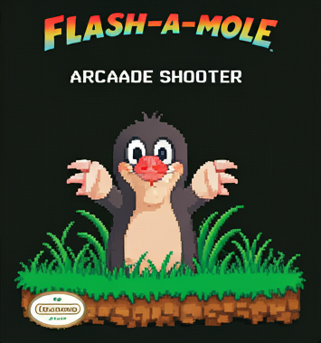
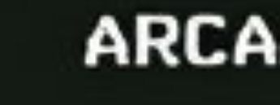
Why Flash-a-Mole?
Fun, challenging design
An arcade-style shooter fulfills both, while also being realizable
Ideation –
Speakers for music
Global leaderboard functionality
Functional toaster and coffee maker
Customizable weapons
Moles that fight back
Time-traveling moles
…?

Slide 3

Theory – PIC18 Techniques
Capture Compare PWM
Pulse Width Modulation
Analog-to-Digital Conversion
Liquid Crystal Display
Light-Dependent Resistors (Photoresistors)

Slide 4
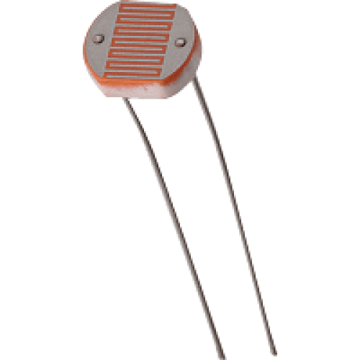
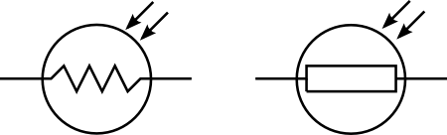
Photoresistors – The Target
A photoresistor is essentially a variable resistor that changes its resistance based on how much light it receives
Higher light concentration yields lower resistance
A "shot" will decrease resistance, and thus create a readable change in voltage
The photoresistors take an average of the environmental light to act as a base

Slide 5

Hardware – What Did We Use?
PIC18f45k22
LCD
Photoresistors (4x)
Servomotors (4x)
Blue LEDs (4x)
Buttons (2x)
100Ω Resistors (4x)
10kΩ Resistors (2x)
Pull-up Resistor
Laser Pointer

Slide 6
Hardware Design
Pho

Slide 7
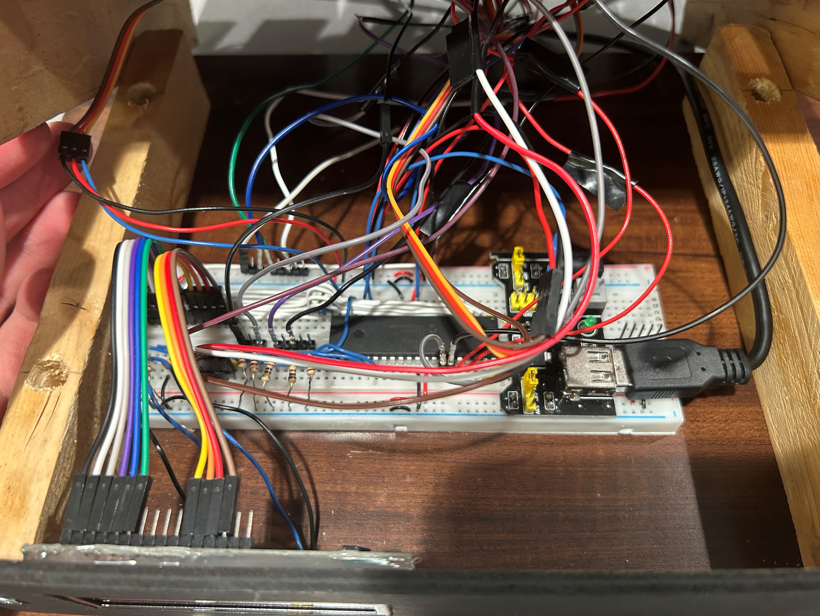
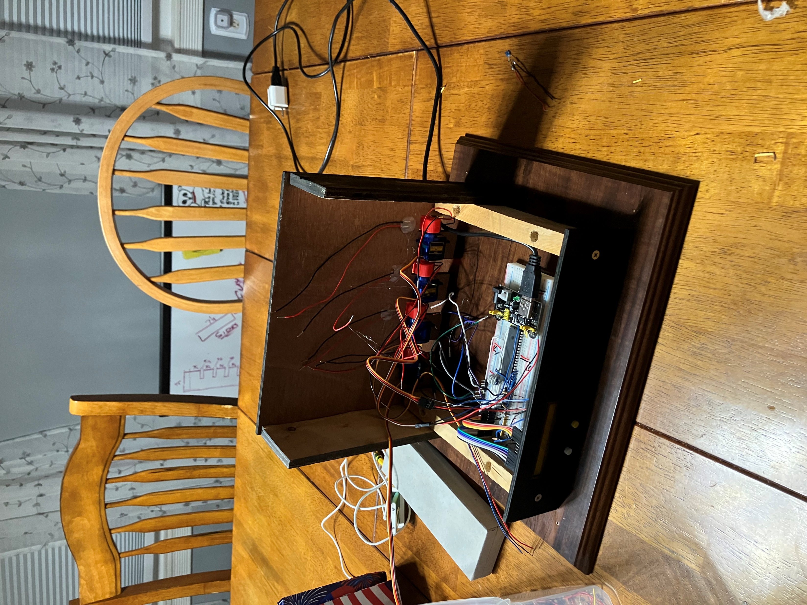
Hardware Design
Box necessary for aesthetic purposes
Space is a limited commodity, so only one breadboard was used

Slide 8
Software Design
Start
State 0
Calibrate
Print Startup Screen
Next State
State 1
Check Buttons
B1
Next State
State 2
Print Menu
Next State
State 3
Print Mode
Next State
From states 6, 7, 11
State 4
Check Buttons
B2
Increment Mode
State 3
B1
Select mode

Slide 9
State 4
Check Buttons
B2
Increment Mode
State 3
B1
?
?
State 2
Set Next State
Init Variables & Screen
5
817 LINES
?
6 or 7
Servos Down
Countdown
B1 or B2
State 6/7
Check Buttons
LED off
Photoresistors
Hit
Hit Logic
Servo Randomizer & Timer
N
Valid Hit?
END
Y
State 11
Print Score
Servo Down
++score
Check Buttons
B1 or B2

Slide 10
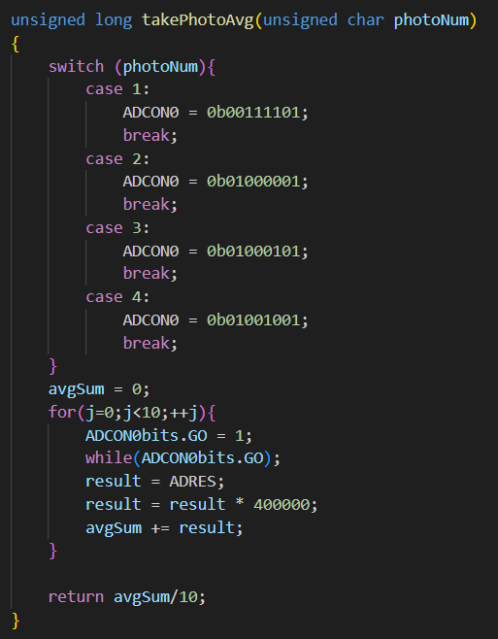
Software Decisions
Why states?
Modular Design
Random number generator
Easter Egg

Slide 11
Demonstration
Body Text…if this is still here, delete it

Slide 12
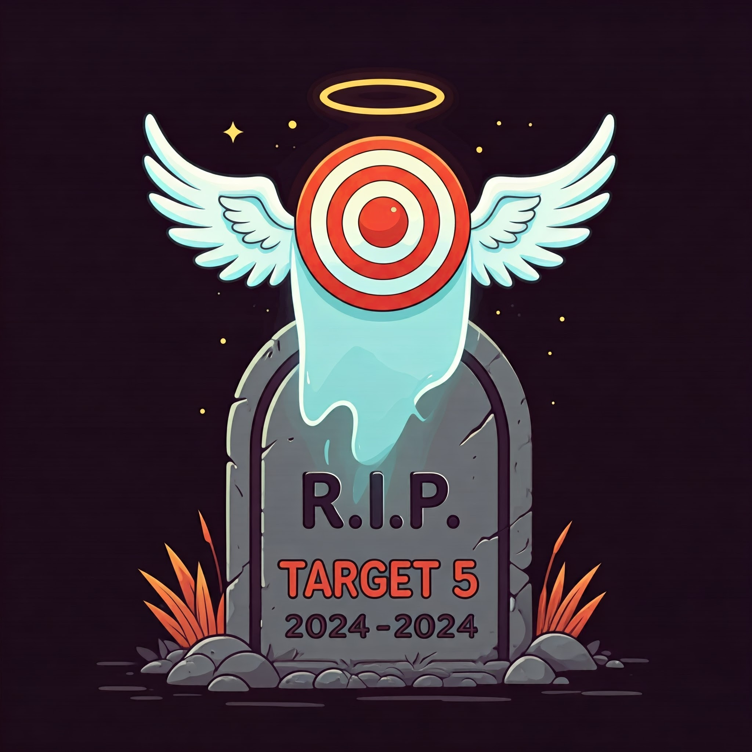
Difficulties and Challenges
Issues getting all 5 Servo motors to work simultaneously
Unable to get Git running properly
Power module had finnicky button, Cedar-borrowed another one
Certain power sources do not provide enough power
"Accidentally" killed Target 5
Ghost of Target 5 haunting the project
Photoresistors are very small targets

Slide 13
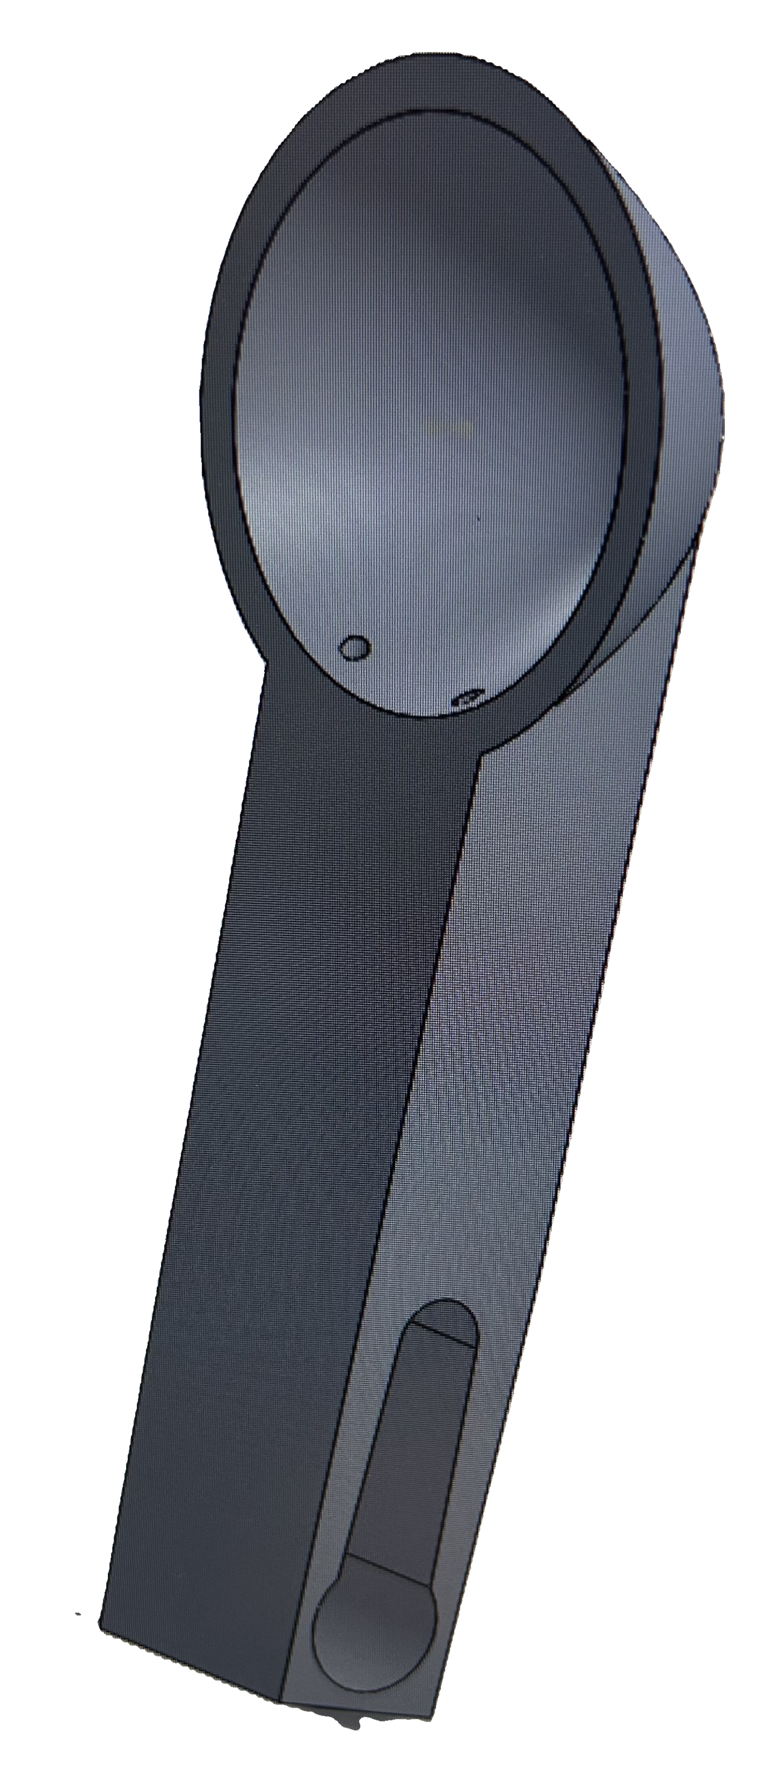
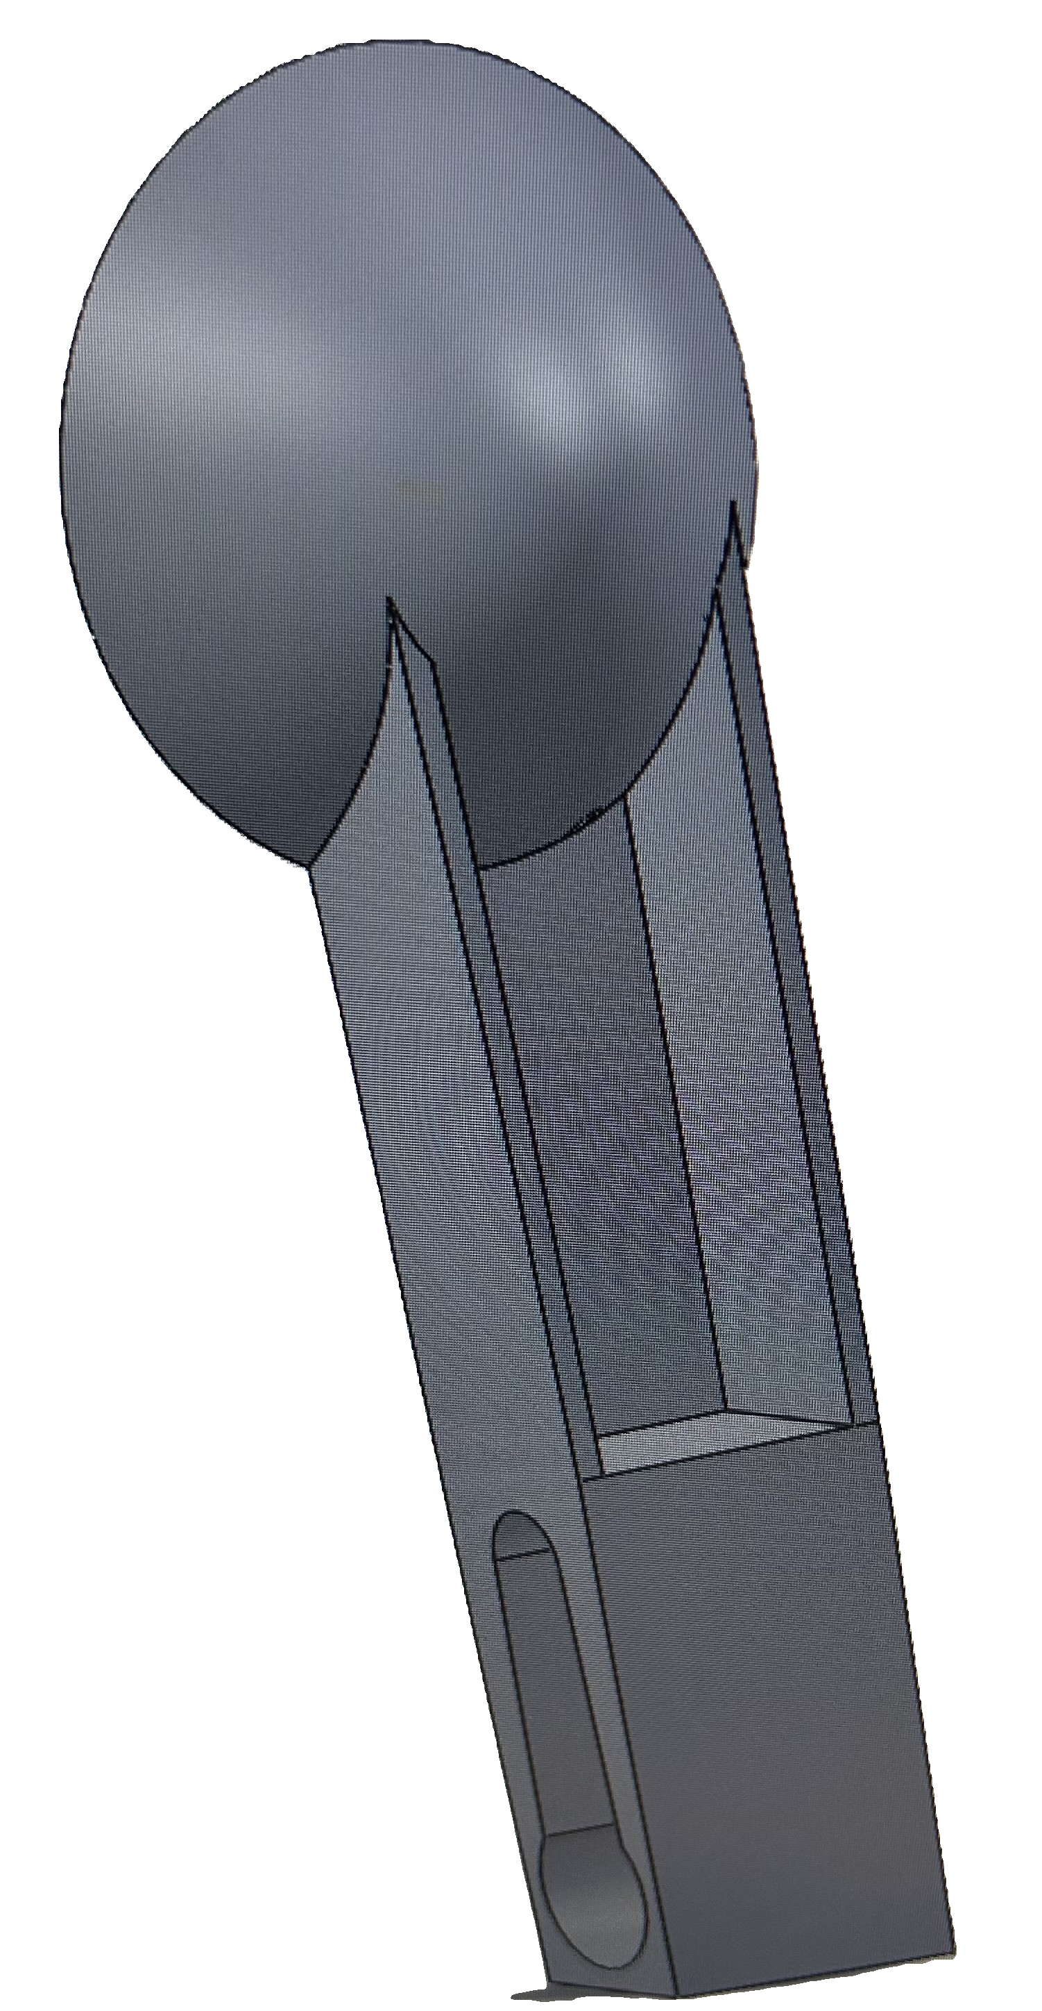
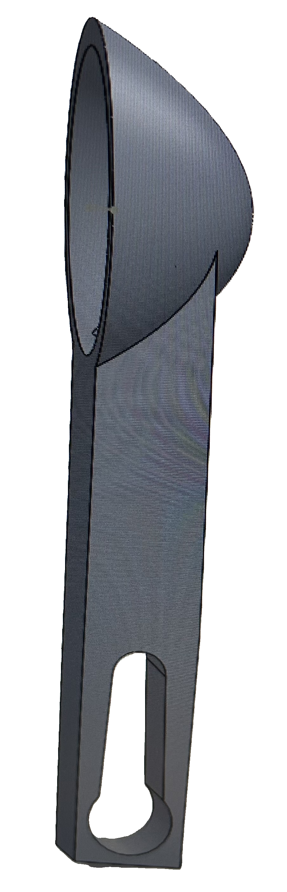
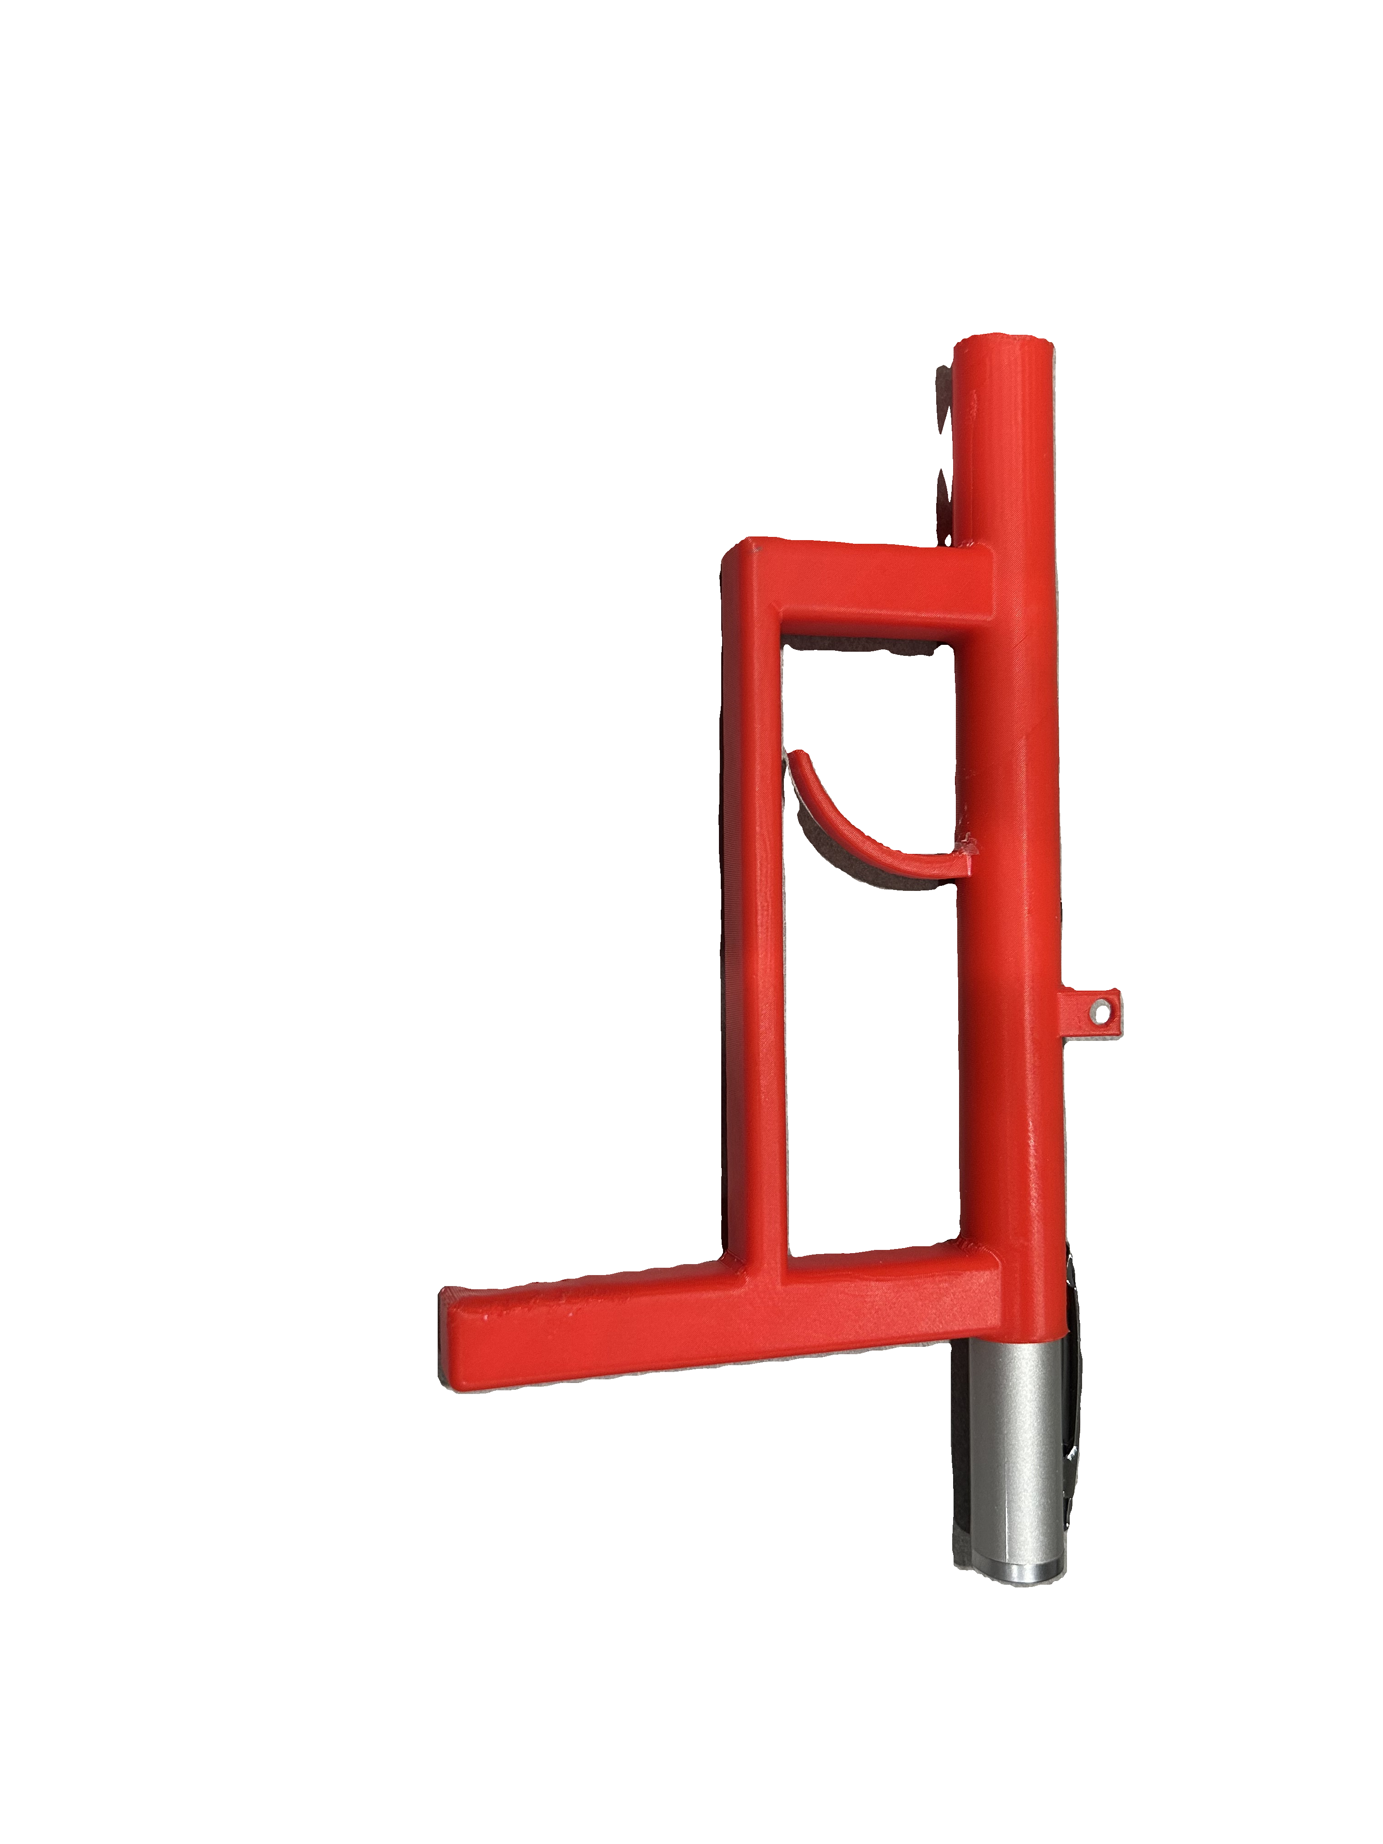
SolidWorks Design
Photoresistors are difficult to hit
Solution: Add a parabolic dish covered in tin foil
Spoon design that attaches to the servomotor and holds the photoresistor
Open back for wires
Wii-Inspired laser pointer attachment

Slide 14

Security Problems
Code is written in C
High voltage can be detrimental
Hardware is easily accessible
Very easy to access the code
Can be used as a blunt object

Slide 15

Societal, Global, Enironmental, Economic Factors
Each unit uses a considerable amount of plastic
Includes small pieces that could easily be broken off and become a choking hazard
Gun attachment may contribute to violent behavior in youths
Game title may entice young children to harass actual moles
Laser pointer contributes approximately 2.6 lux of light pollution per shot
Assuming a hit, product will benefit the economy

Slide 16


